Slide 1
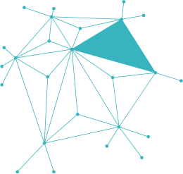
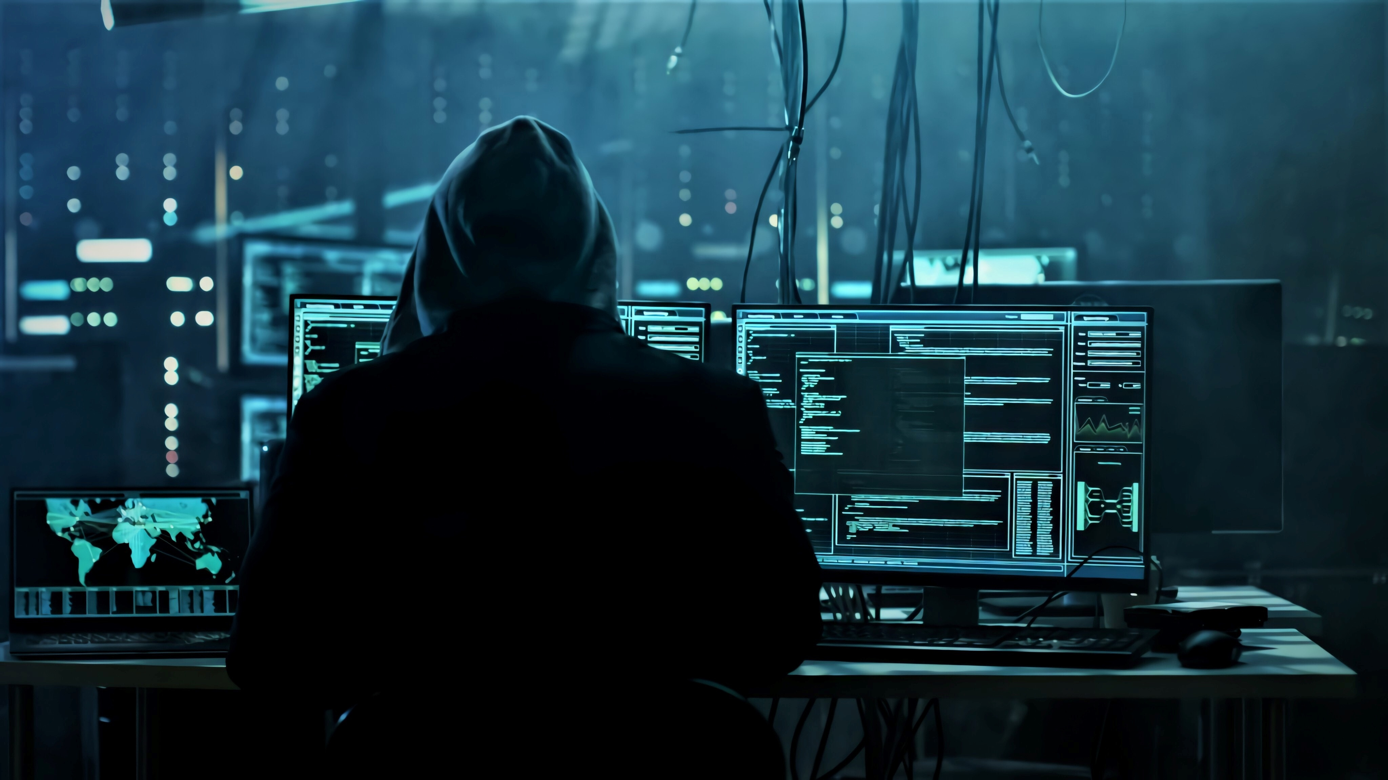
धर्मो
रक्षति
रक्षितः
Shielding Against Cyber Threats

Slide 2


PROJECT
OVERVIEW
is an all-in-one cybersecurity toolkit designed to protect, analyze, and test the digital environment. It integrates essential tools including a keylogger, steganography, a password manager and generator, and a malware detection module. This suite is aimed at ethical hacking, digital forensics, and secure data management.
Built using Python and modular design, it allows both beginners and professionals to explore multiple layers of cybersecurity in one environment.
धर्मो रक्षति रक्षितः

Slide 3
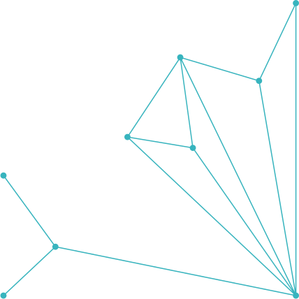
CORE
MODULES
Designed to teach, secure, and simulate real-world cyber environments.
EACH TOOL, ONE MISSION: TOTAL CONTROL OVER DIGITAL THREATS.
Keylogger
Steganography Tool
Password Manager & Generator
Malware Detector
Captures keystrokes for monitoring and forensic investigation in a legal/controlled environment.
Conceals messages or files inside images to enable hidden communication.
Securely stores and creates strong, encrypted passwords for user safety.
Scans for suspicious code signatures and known malware behaviors in files.

Slide 4




KEYLOGGER MODULE
Did you know?
Every keystroke tells a story — we just listen to it.
A silent keylogger can record everything you type — without you ever noticing.
A Keylogger is a monitoring tool that records every keystroke made on a system’s keyboard. It helps in activity analysis, security auditing, and user behavior tracking in a controlled or ethical hacking environment.
Tailored Solutions
A custom keystroke tracker for specific monitoring needs.
Why It's Used (Real-life Use Cases)
Forensics: Used by cybersecurity professionals to analyze digital evidence during investigations.
Parental Control / Internal Monitoring: Employers or parents may monitor systems to ensure safe and legal use.
Ethical Hacking Labs: Security researchers test system vulnerabilities and data leakage points.
It can violate privacy if misused or installed without consent.
Proactive Monitoring
Stay ahead of threats — don’t wait for them to strike.

Slide 5
STEGANOGRAPHY
Because the best secrets are the ones you never see.
Did you know?
Steganography is the art of hiding information in plain sight — like embedding secret messages inside images. This module allows users to conceal text data within image files, making it invisible to the naked eye but retrievable with the right key.
Unlike encryption, which scrambles the content, steganography hides its very existence, making it ideal for covert communication, secure data transfers, or digital forensics.
A normal image even voice can secretly carry hidden messages using steganography.
Tailored Solutions
Not just hidden — customized, protected, and precise.
Why It's Used (Real-life Use Cases)
Intelligence & Espionage: Agents may hide mission-critical data in seemingly normal files.
Digital Forensics: Investigators may embed notes or case details inside media files during analysis.
Private Communication: Journalists or whistleblowers use it to bypass surveillance and censorship.
Proactive Monitoring
Stealth isn’t enough — awareness is the second layer of defense.

Slide 6

MALWARE
DETECTOR
Did you know?
Spot the threat before it spreads.
Over 300,000 new malware programs are created every day.
Malware detection is the core defense mechanism of SHIELD — scanning, analyzing, and identifying malicious files or suspicious behavior in real-time. This module is designed to catch threats before they can execute, using signature checks, file behavior analysis, and extension monitoring.
Whether it's a virus, trojan, or a disguised payload, this tool inspects the system like a digital bloodhound.
Tailored Solutions
Not every threat looks the same — not every solution should either.
Why It's Used (Real-life Use Cases)
Corporate Security: Detects malicious attachments or scripts inside enterprise files.
Pen-testing Labs: Helps ethical hackers identify potentially harmful files during vulnerability testing.
Forensics & Law Enforcement: Used to examine seized digital evidence for embedded threats.
Proactive Monitoring
Because real threats don’t wait — and neither do we.

Slide 7
PASSWORD MANAGER & GENERATOR
Did you know?
Most data breaches happen due to weak passwords.
Secure, generate, and defend — all in one vault.
These module is a dual-purpose tool designed to both securely manage your passwords and detect weak or reused credentials. It stores login information in encrypted form, auto-generates strong passwords.
Built for both convenience and safety, it minimizes the human risk in cybersecurity — no more using “123456” or writing passwords on sticky notes.
Tailored Solutions
One vault — many ways to protect what matters.
Why It's Used (Real-life Use Cases)
Students & Individuals: Secure all account credentials with one master key.
Offices & Teams: Generate and share encrypted passwords securely.
Security Audits: Detect reused or weak passwords during internal reviews.
Proactive Monitoring
Security that doesn’t sleep — always watching, always protecting.

Slide 8


THE
CYBER
AWARENESS
CHALLENGE
The Cybersecurity Quiz module is designed to engage users, test their knowledge, and promote awareness of digital threats. With a mix of beginner to advanced questions, this interactive tool sharpens your understanding of real-world cyber attacks, safety practices, and digital hygiene.
Whether you're a student, enthusiast, or aspiring ethical hacker — it’s time to see how secure your mind really is.
Every right answer builds your firewall — one question at a time.

Slide 9

SECURITY
AUTHENTICATION
Safe & Encrypted Environment
No Data Storage
Educational & Ethical Use Only
Secure Login System will be added soon
Awareness-Focused Design
No Hidden Trackers and malicious free
Built with security, transparency, and user privacy at its core — empowering users without compromising safety.

Slide 10
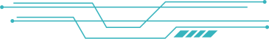



UNDER T
HE HOOD
-TECHSTACK USED
HTML
CSS
PYTHON
JAVASCRIPT
Styling and layout and responsiveness.
Core logic for tools like keylogger, steganography, malware detection, and password management.
Interactivity and dynamic behavior.
Structure of the web pages.
≈ 34.27%
≈ 27.02%
≈ 23.78%
≈ 14.94%

Slide 11
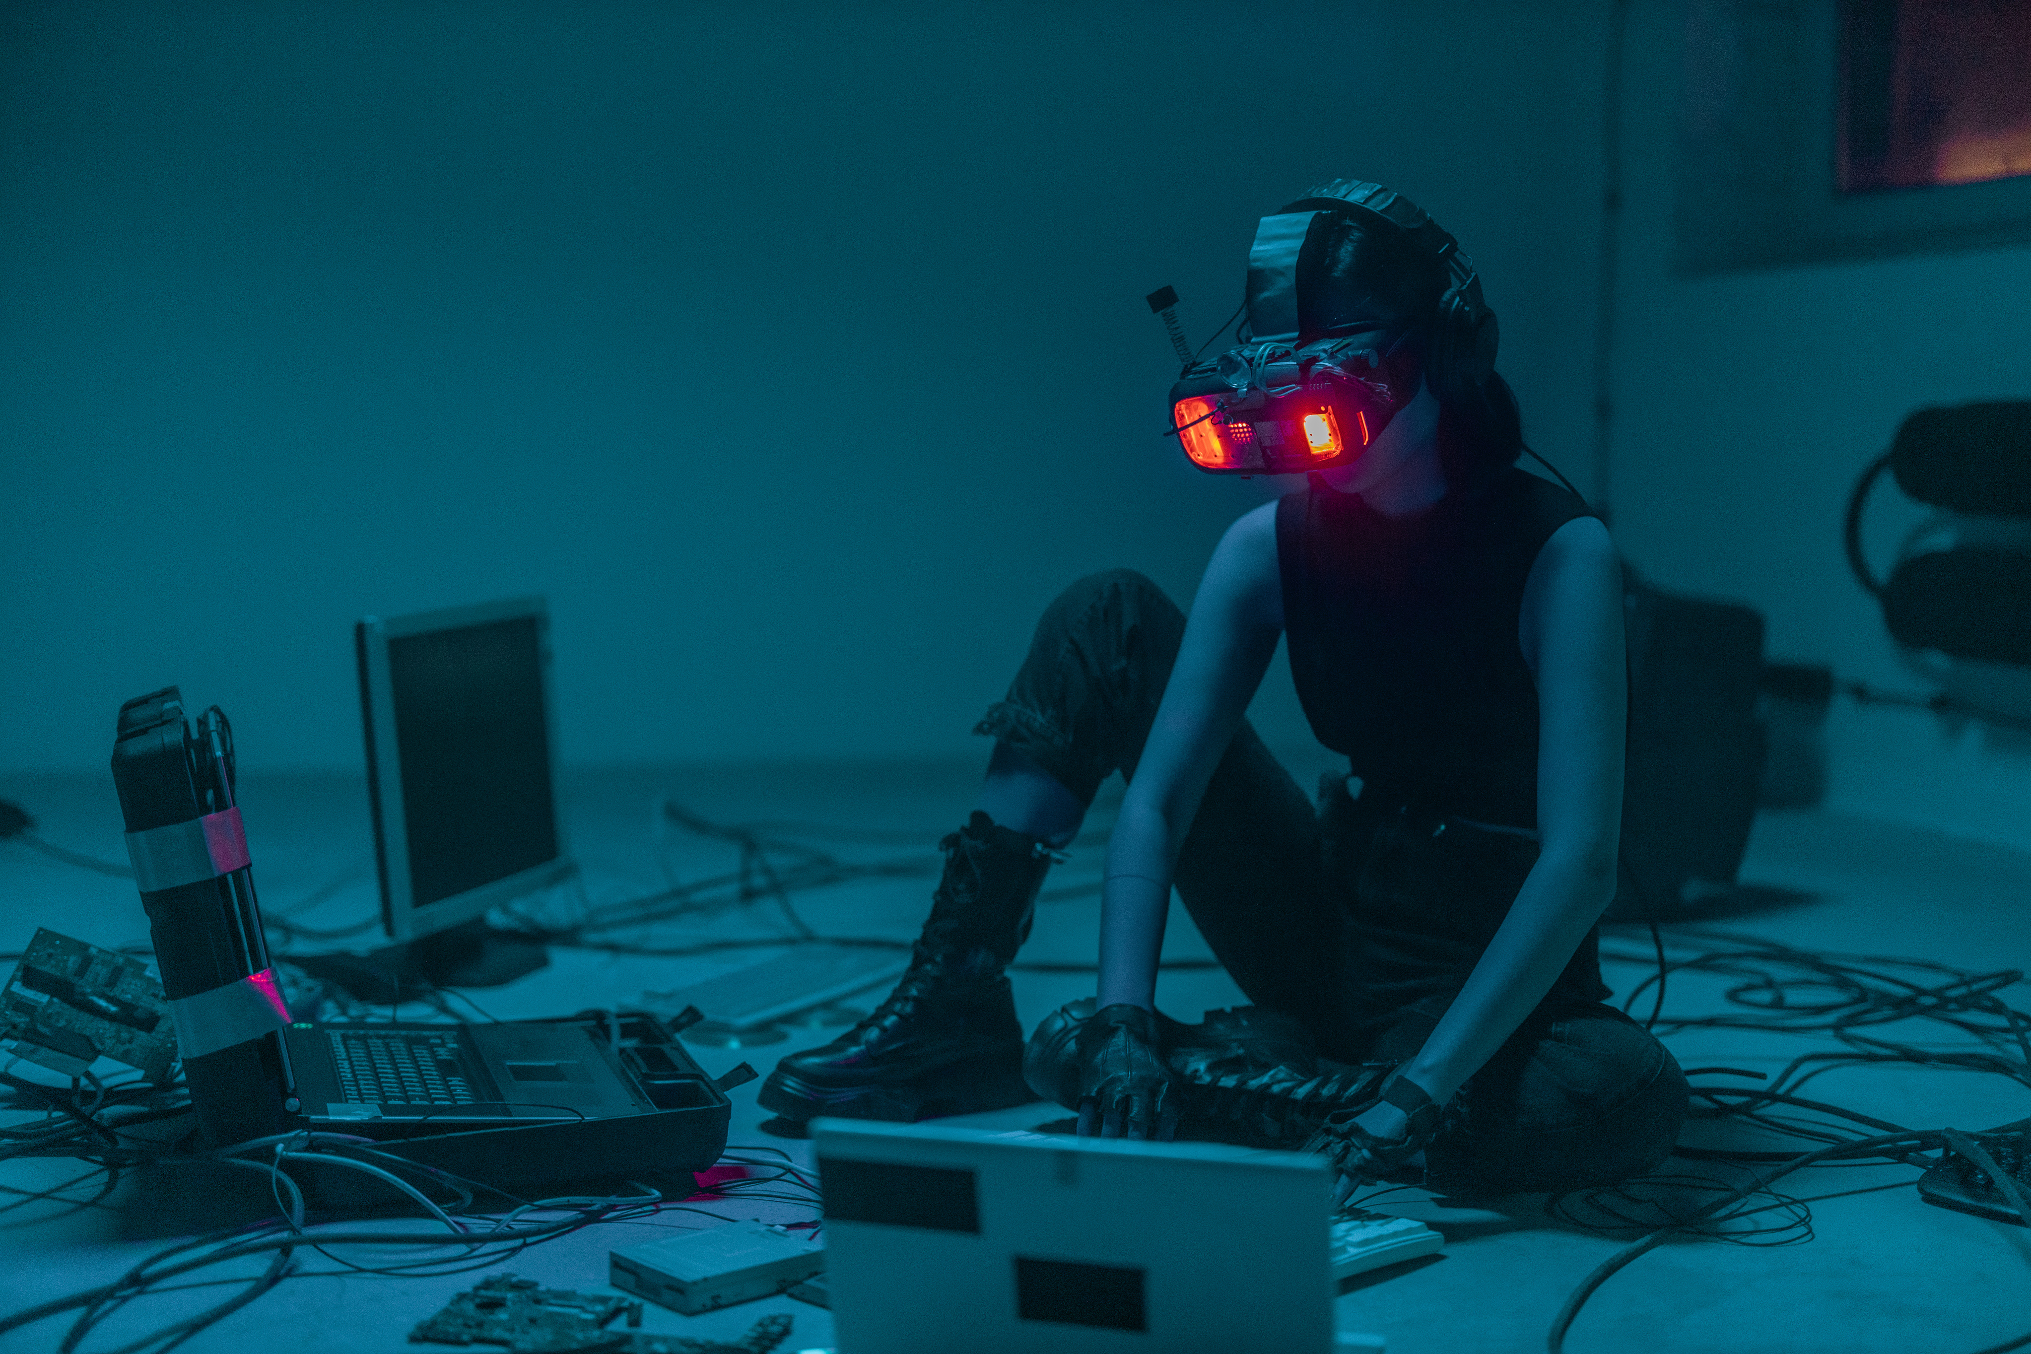



MODERN INFORMATION
PROTECT FROM
HACKERS
Disable Auto-Download in Messaging Apps
Avoid Clicking Suspicious Links
Enable Two-Factor Authentication (2FA)
Avoid Public Wi-Fi for Sensitive Transactions
Never Install Unknown APKs or Software
Check App Permissions
OUTCOME
Cyber
Threat
Awareness
Learning Through Interaction
Motivation to Practice Safe Digital Habits

Slide 12



WHERE WE
ARE HEADED NEXT
Innovation doesn't stop here.
Integration of AI-Powered Threat Detection.
Expanding boundaries, enhancing security.
Multi-Factor Authentication (MFA).
From private roots to public power.
Open Source : Currently private, but planning to go
public for community contributions.
Today
Tomorrow
Day After Tomorrow
From Project to Product
One idea. One vision. Global impact.

Slide 13



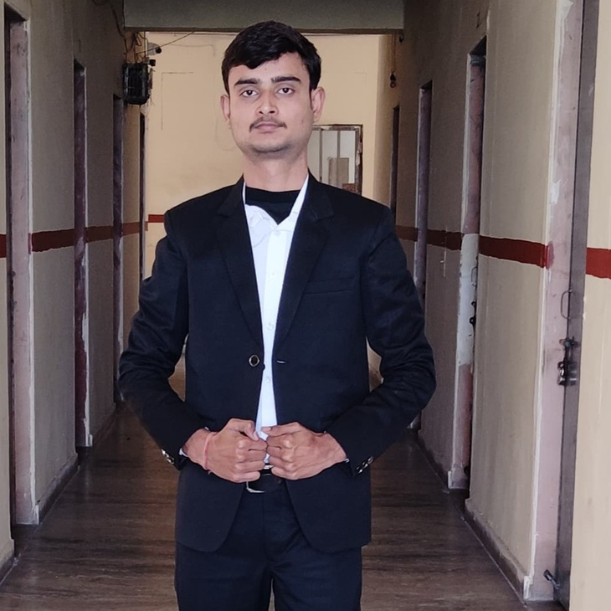
OUR AMAZING
TEAM
Anshika
Ayush Rathore
Devansh Gupta
Anurag Singh
JavaScript & Support Developer
Lead developer & Cybersecurity Enthusiasts
Web Designer & Cyber Ethusiasts
Currently not joined

Slide 14

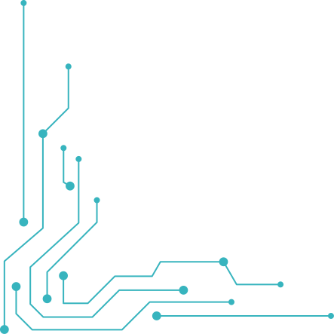


THANKS FOR
JOINING THE CYBER MISSION
We appreciate your time and attention.
This project is not just a toolkit — it’s a mission to raise awareness, strengthen defenses, and build a safer digital world.
Together, we can turn ideas into innovations and challenges into change.

